Slide 1


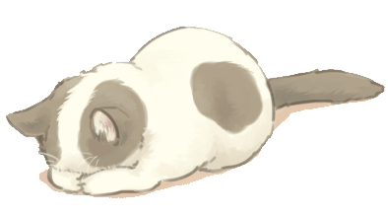
Continuation Writing
读后续写讲评
Click here to enter your text.Click here to enter your text.Click here to enter your text.Click here to enter your text..Click here to enter your text.

Slide 2
目
CONTENTS
01
快速阅读，精准理解
录
02
理清思路，把握全局
03
推动情节，展开续写
04
积累素材，激活表达

Slide 3
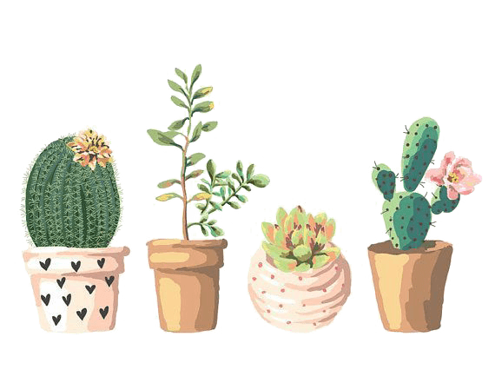
01 Careful Reading

Slide 4





Step 1：精深语篇，精准理解
Para. 1
Having taken part in the inter-school storytelling championship for the past two years, I was a shining star of my school. When it came to choosing the right candidate to participate in such competitions, I was always the first choice. Naturally, I was once again selected to represent my school in the approaching contest this year.
★ championship n [认知词汇] 冠军
★ candidate [认知词块] 候选人
★ when it come to (doing) sth [输出词块] 当提及到做某事时
★ be selected to [动作词汇] 被选择

Slide 5
Para. 2
Upon hearing the fact that I was chosen again, my classmates and friends acknowledged that I would undoubtedly emerge as the champion again. Consequently, I became conceited (自负的). I was so proud that I neglected the importance of practicing for the contest.
★ proud adj [读后续写心理词汇] 骄傲，自豪
★ neglect v [认知词块] 忽视
★ upon hearing sth that [输出词块] 一听闻某事...

Slide 6
Para. 3
A week before the contest, my teacher Ms. Sara asked, “Selena, would you like to stand in front of the class to rehearse for the contest?” She had tutored me in the past two competitions and knew how important practice was. “Just imagine you are on the stage in the presence of the audience,” she added.
“I’m sorry, Ms. Sara,” I replied. “I have a bit of a sore throat.”
★ rehearse v [认知词汇] 排练，演习
★ tutor [认知词块] 导师；辅导
★ in the presence of [输出词块] 在...面前

Slide 7
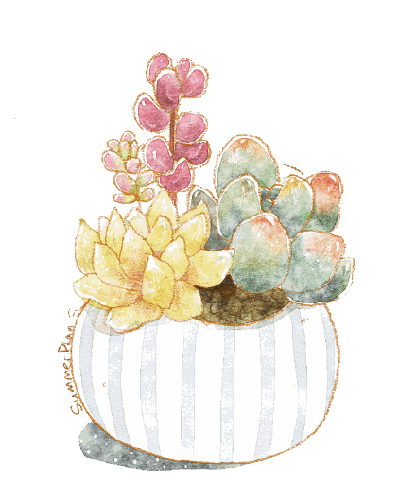
（4）“I’m sorry, Ms. Sara,” I replied. “I have a bit of a sore throat.”
（5）This was usually the lie I would tell whenever my teacher requested me to practice in front of the class. I always found excuses to avoid doing it because I believed that I was the best and therefore the practice was unnecessary. On one occasion, I even told Ms. Sara not to worry too much as I was well prepared for the contest. In fact, I did everything but practice my script. I only managed to glance briefly through the story the day before the contest. As the best storyteller among the students of the local secondary schools, I was too vain to practice and expected everything to be fine.
sore 疼痛的
On one occasion 一次
but prep. 除…外
glance 瞥见，扫视
briefly 简略地
contest 比赛
vain 徒劳的，自负的

Slide 8
（6）The contest was being held in the local community hall. On the day of the contest, the hall was packed. My school teachers and principal were there along with many of my classmates and schoolmates. I was the eighth contestant out of twenty in total. Those who spoke before me did extremely well. On seeing their fascinating and outstanding performance, I began to lose confidence in myself. My palms sweated heavily and I started to feel nervous.
pack v. 打包，挤满
principal 校长

Slide 9
Reading for basic information
when
When I was in secondary school
where
at school/ at the stage of a speech contest
who
Ms. Sara and “I”
what
I was going to take part in a storytelling contest again after winning championship for the past two years

Slide 10
Step 2：理清思路，把握全局
本文是一篇记叙文，讲述了我狂妄自大地认为自己已经是演讲得最好的人了，甚至是老师在要求我练习的时候也总是找借口逃避。当我在看到其他参赛选手表现非常出色的时候，开始着急、担心了。最后通过自己的失败明白了骄兵必败和熟能生巧这些道理。

Slide 11
Step 2：理清思路，把握全局
Para. | 语篇结构关键词
1 因多次参加校际讲故事比赛获奖，成为学校一颗闪亮的明星 | inter-school storytelling championship a shining star of my school
2 再一次选为学校代表 | I was chosen again to represent my school in the approaching contest
3-5 比赛前，老师萨拉要求“我”在全班面前练且习，我通常都会撒谎 | to rehearse in front of the class for the contest “I’m sorry, Ms. Sara,” I replied. “I have a bit of a sore throat.”ont of the class to rehearse for the contest
6 比赛中，介绍比赛情形及对手出色的表现 | Those who spoke before me did extremely well. to lose confidence in myself. My palms sweated heavily and I started to feel nervous.（作者的心情）

Slide 12
Logically writing

Slide 13
Step 3：推动情节，展开续写
文章通过情节线“我”成为闪亮的校际讲故事明星—再一次选为学校代表—忽视练习的重要性—？”和情感线“自负—紧张—尴尬/羞愧—？”
根据情节线和感情线可以清晰理清篇章结构和接下来的发展脉络，即作者上场表演及在台上的表现，可能表演糟糕，以及作者的情感变化：尴尬、羞愧、后悔、反思等。

Slide 14
Step 3：推动情节，展开续写
my turn to talk
seeing others’ outstanding performance
nervous
be asked to practice in front of the class
?
unwilling（avoid）
be representative again
development
conceited
to be continued…
shining star
proud
Beginning
Ending

Slide 15
Step 4：积累素材，激活表达（细节描写词汇）
细节描写：
动作线：作者在台上的表现（侧重面部表情、心理活动、肢体动作等人体与动作的细节描写）
情感线：作者的情感变化（侧重尴尬等情感描写）
还可描写老师和评委的表情：失望等

Slide 16
make inference of plots
make inference of plots
Para.1 Soon, it was my turn to talk.
第一段可描写作者由于赛前没有练习，准备不充分，表演的时候非常紧张，甚至表现出口吃结巴和忘词等。这次的表演非常糟糕，以致评委和支持者们很失望。
作者感觉从来没有这么尴尬过，心里很懊悔，眼含着泪水走下舞台。
Para.2. Finally, results were announced after the contest.
不充分的准备会有什么结果呢？（而且对手表现很出色……）
还会继续得奖吗？
面对不好的结果，会有哪些感想？

Slide 17
Step 4：积累素材，激活表达（细节描写词汇）
人体与动作描写（面部表情、心理活动、肢体动作等） | 情感描写（尴尬、失望和遗憾等）
面无表情地说话 speak without expression 口吃 cannot speak fluently/stutter 张目结舌地站在那里 stand there tongue-tied 紧张地剁脚 tap one's feet nervously 摇头 nobody gives a nod/shook head 忘词 can't remenber those word anyway 腿颤抖 tremble 眼睛紧盯着某人的脸 one’s eyes fix on sb’s face | 词： disappoint (disappointed, disappointing), discourage, embarrassed, awkward, pity, shame (ashamed), regret (regretful), sorry, guilty hopeless 词块： let sb down lose heart

Slide 18
Possible Version

Slide 19
Paragraph 2: Finally, results were announced after the contest. I did not win any prizes, which was not surprising at all. I felt ashamed when I faced my classmates and Ms. Sara. I regretted underestimating my opponents and overestimating myself. My pride had cost me the championship. I regretted being so arrogant. I had learned my lesson well and finally understood the meaning of the saying, “Pride goes before a fall.”
Paragraph 1: Soon, it was my turn to talk. …………
结果
感受1
第一段：台上表现
感受2
台上表现如何？
台下反应如何？
我的感受如何？
反思总结1
感受3
反思总结2

Slide 20
evaluating and imitating
make inference of plots
Paragraph 1: Soon, it was my turn to talk. Facing the crowd, I found myself suffering from stage fright. I spoke in a nervous voice and was even tongue-tied a few times as I forgot parts of the story. My legs trembled and so did my voice. Seeing my terrible performance, the judges shook their heads. The supporters from my school looked at me in disappointment. I had never been so embarrassed in my life. In the end, I walked off the stage, head hung, tears in my eyes.

Slide 21
Paragraph 2: Finally, results were announced after the contest. I did not win any prizes, which was not surprising at all. I felt ashamed when I faced my classmates and Ms. Sara. I regretted underestimating my opponents and overestimating myself. My pride had cost me the championship. I regretted being so arrogant. I had learned my lesson well and finally understood the meaning of the saying, “Pride goes before a fall.”
Paragraph 2: Finally, results were announced after the contest. …………
结果
感受1
第二段：比赛后续
第二段：比赛后续
感受2
结果是什么？
感受如何？
总结（反思、经验等）
结果是什么？
感受如何？
总结（反思、经验等）
反思总结1
感受3
反思总结2

Slide 22
evaluating and imitating
make inference of plots
Paragraph 2: Finally, results were announced after the contest. I did not win any prizes, which was not surprising at all. I felt ashamed when I faced my classmates and Ms. Sara. I regretted underestimating my opponents and overestimating myself. My pride had cost me the championship. I regretted being so arrogant. I had learned my lesson well and finally understood the meaning of the saying, “Pride goes before a fall.”
结果
感受1
感受2
反思总结1
感受3
反思总结2

Slide 23
Thank you!
Click here to enter your text.Click here to enter your text.Click here to enter your text.Click here to enter your text..Click here to enter your text.

